Slide 1
Microcontrollers
ITE 305 Embedded Systems

Slide 2

What are µCs?

Slide 3
What are µCs?
A microcontroller(µC) is a
small computer.

Slide 4
What are µCs?
A microcontroller(µC) is on a
single integrated circuit.

Slide 5
What are µCs?
A microcontroller(µC) consists of:
a relatively simple central processing unit (CPU) combined with peripheral devices such as
memories,
I/O devices,
and timers.

Slide 6
µCs vs µPs
Program and date storage are mostly in the on-chip internal memory

Slide 7
µCs vs µPs
Required Peripherals are mostly on-chip

Slide 8
µCs vs µPs
Clock speed is mostly limited to few tens of MHz

Slide 9
µCs vs µPs
Many of them are application specific

Slide 10
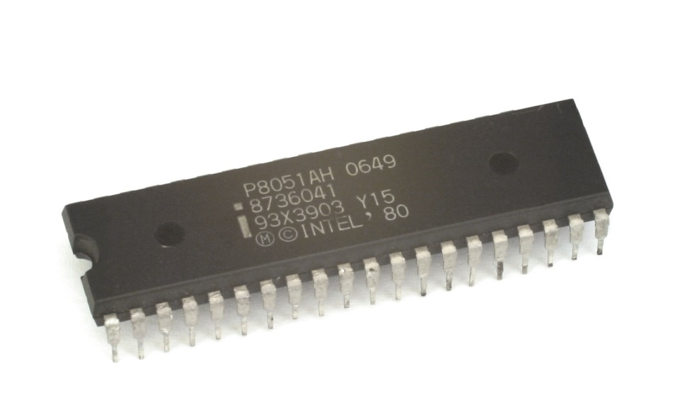
µCs vs µPs

